Slide 1
Presentation topic
Mobo Medicines

Slide 2
Group Members
Muhammad Arbaaz-ul-Rehman
Asad Fayyaz
Roshan Mansoor
Huzaifa Bin Jamal
Tehseen Mazhar

Slide 3
INTRODUCTION
Mobo Medicines is an Online Pharmacy and Medicines Delivery System where you can buy medicines online

Slide 4
SERVICES
24/7 available
Variety of Medicines
Original Medicines
Reasonable Price
Delivery in One Hour

Slide 5
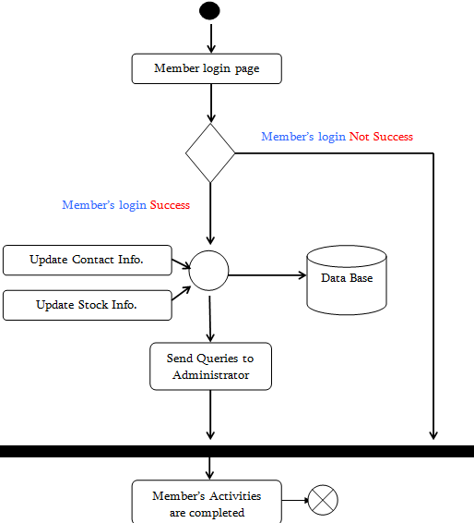
Activity Diagram

Slide 6
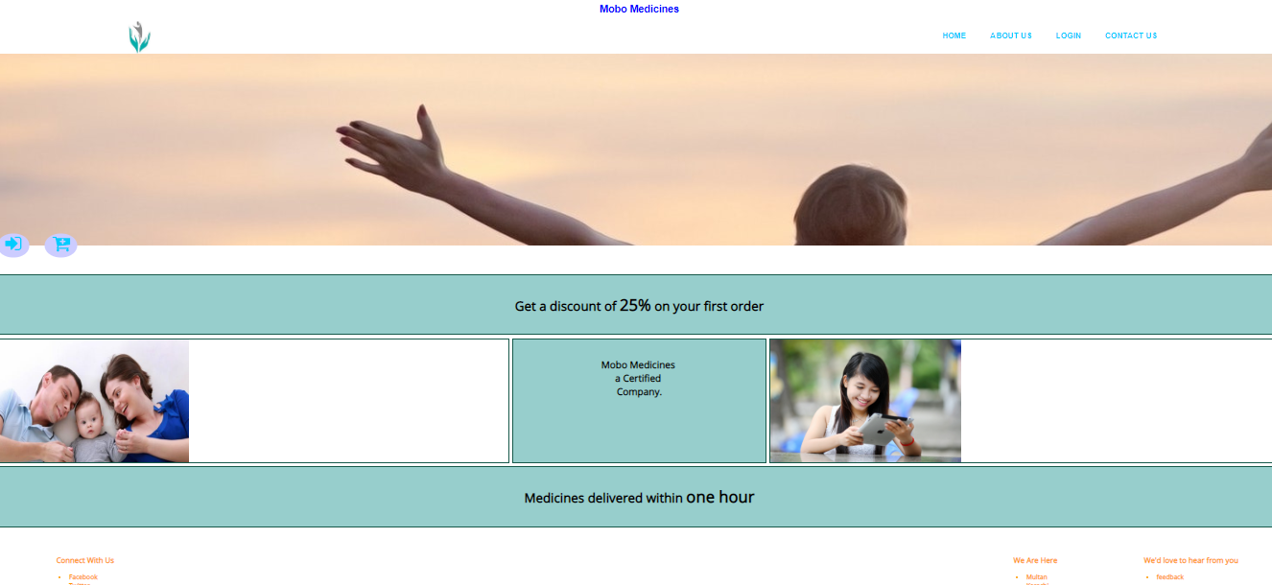
Home Page

Slide 7
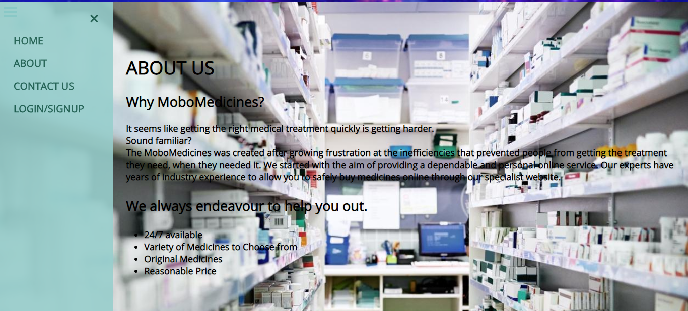
ABOUT US

Slide 8
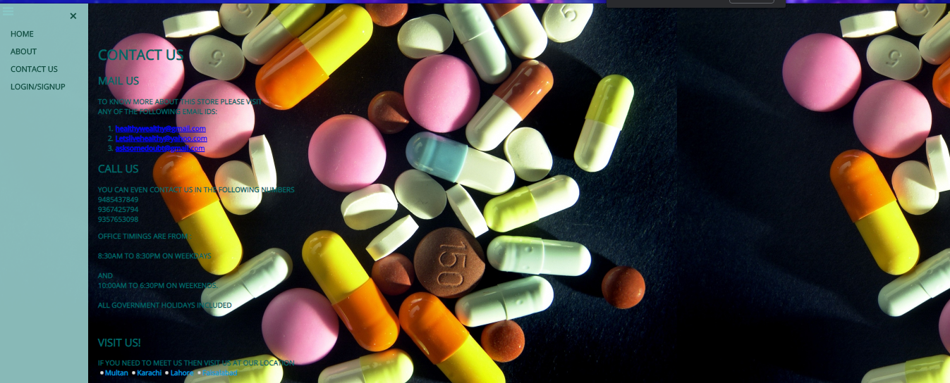
CONTACT

Slide 9
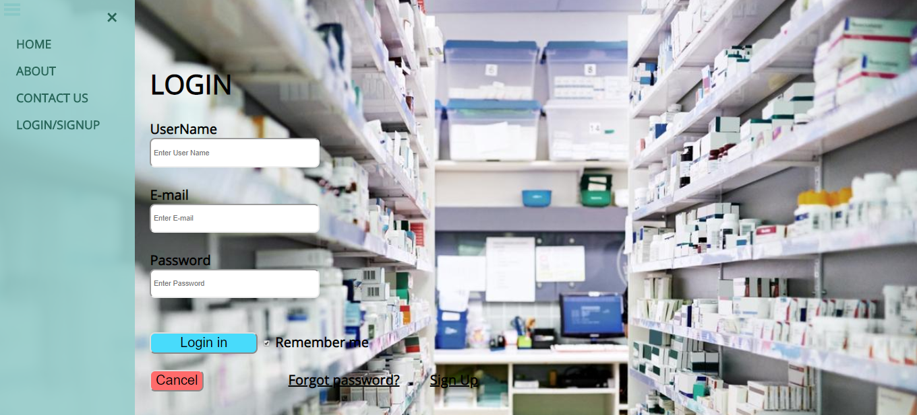
LOGIN

Slide 10

SIGN UP

Slide 11
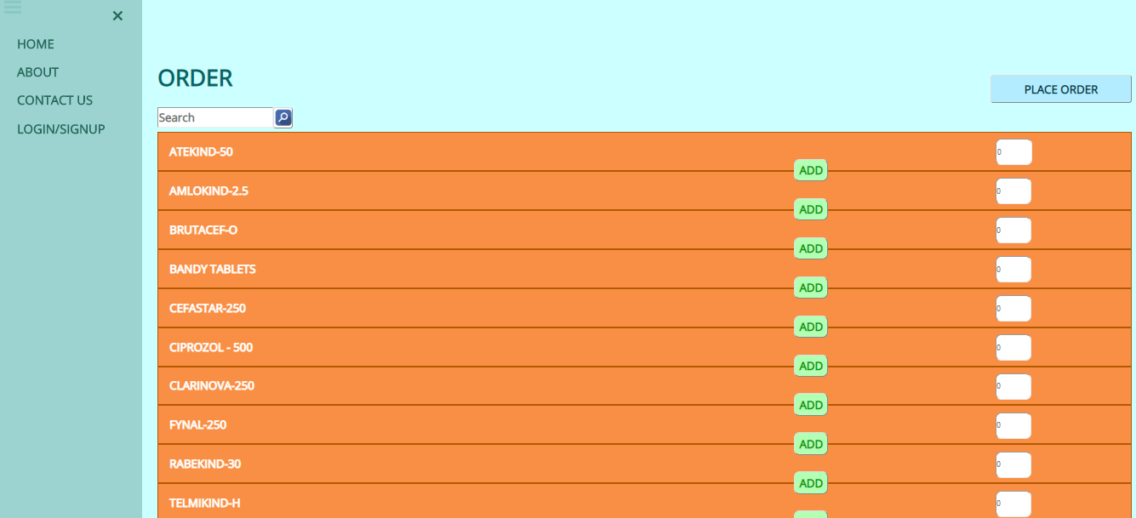
ORDER

Slide 12
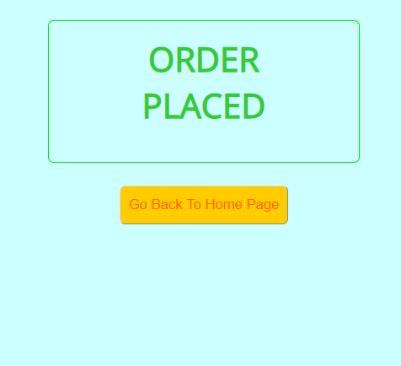
ORDER PLACEMENT

Slide 13
THANKS…

